Slide 1

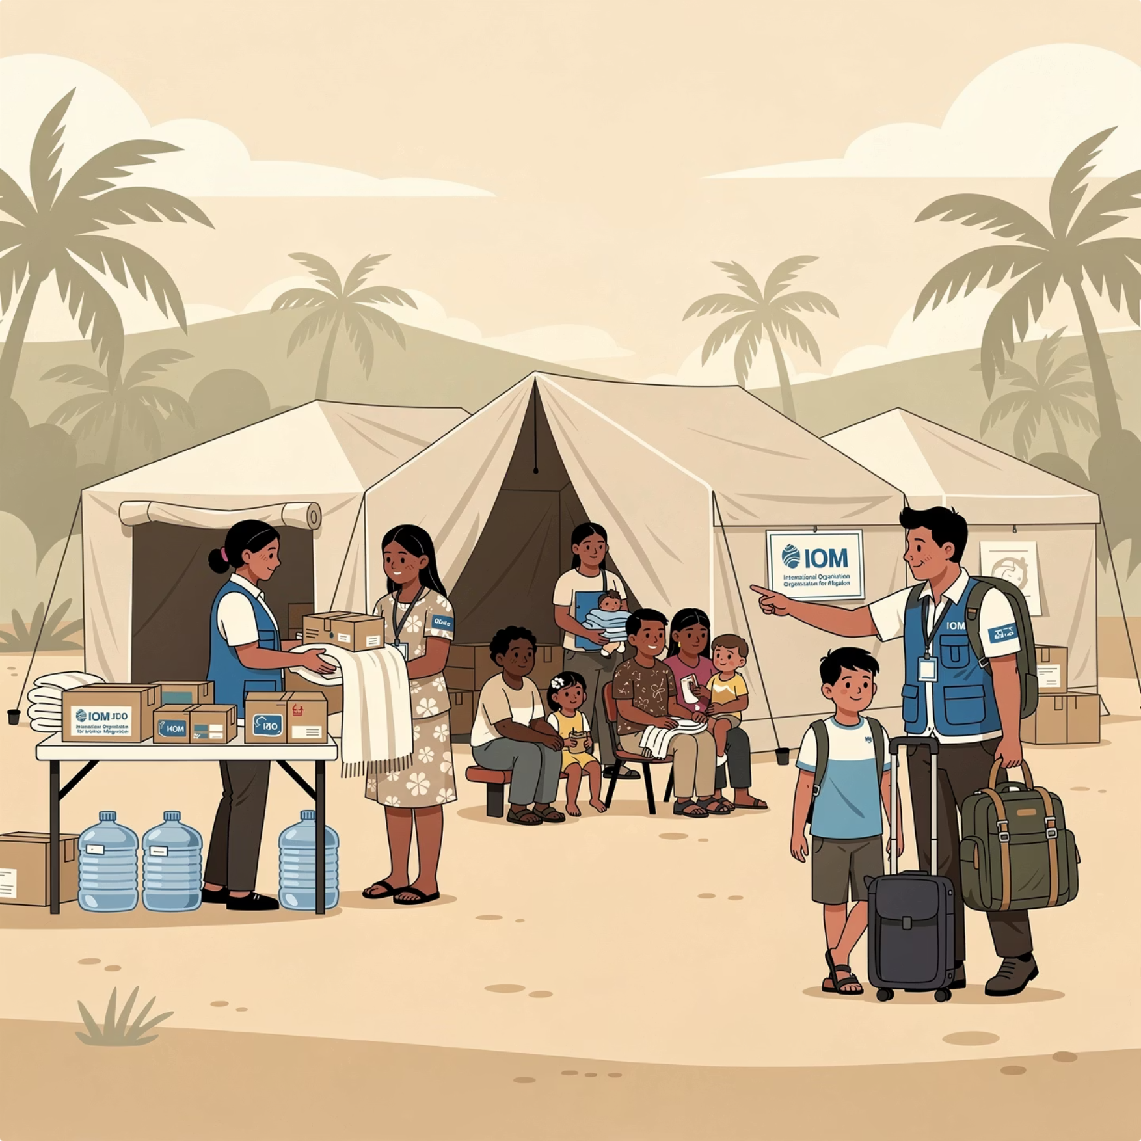
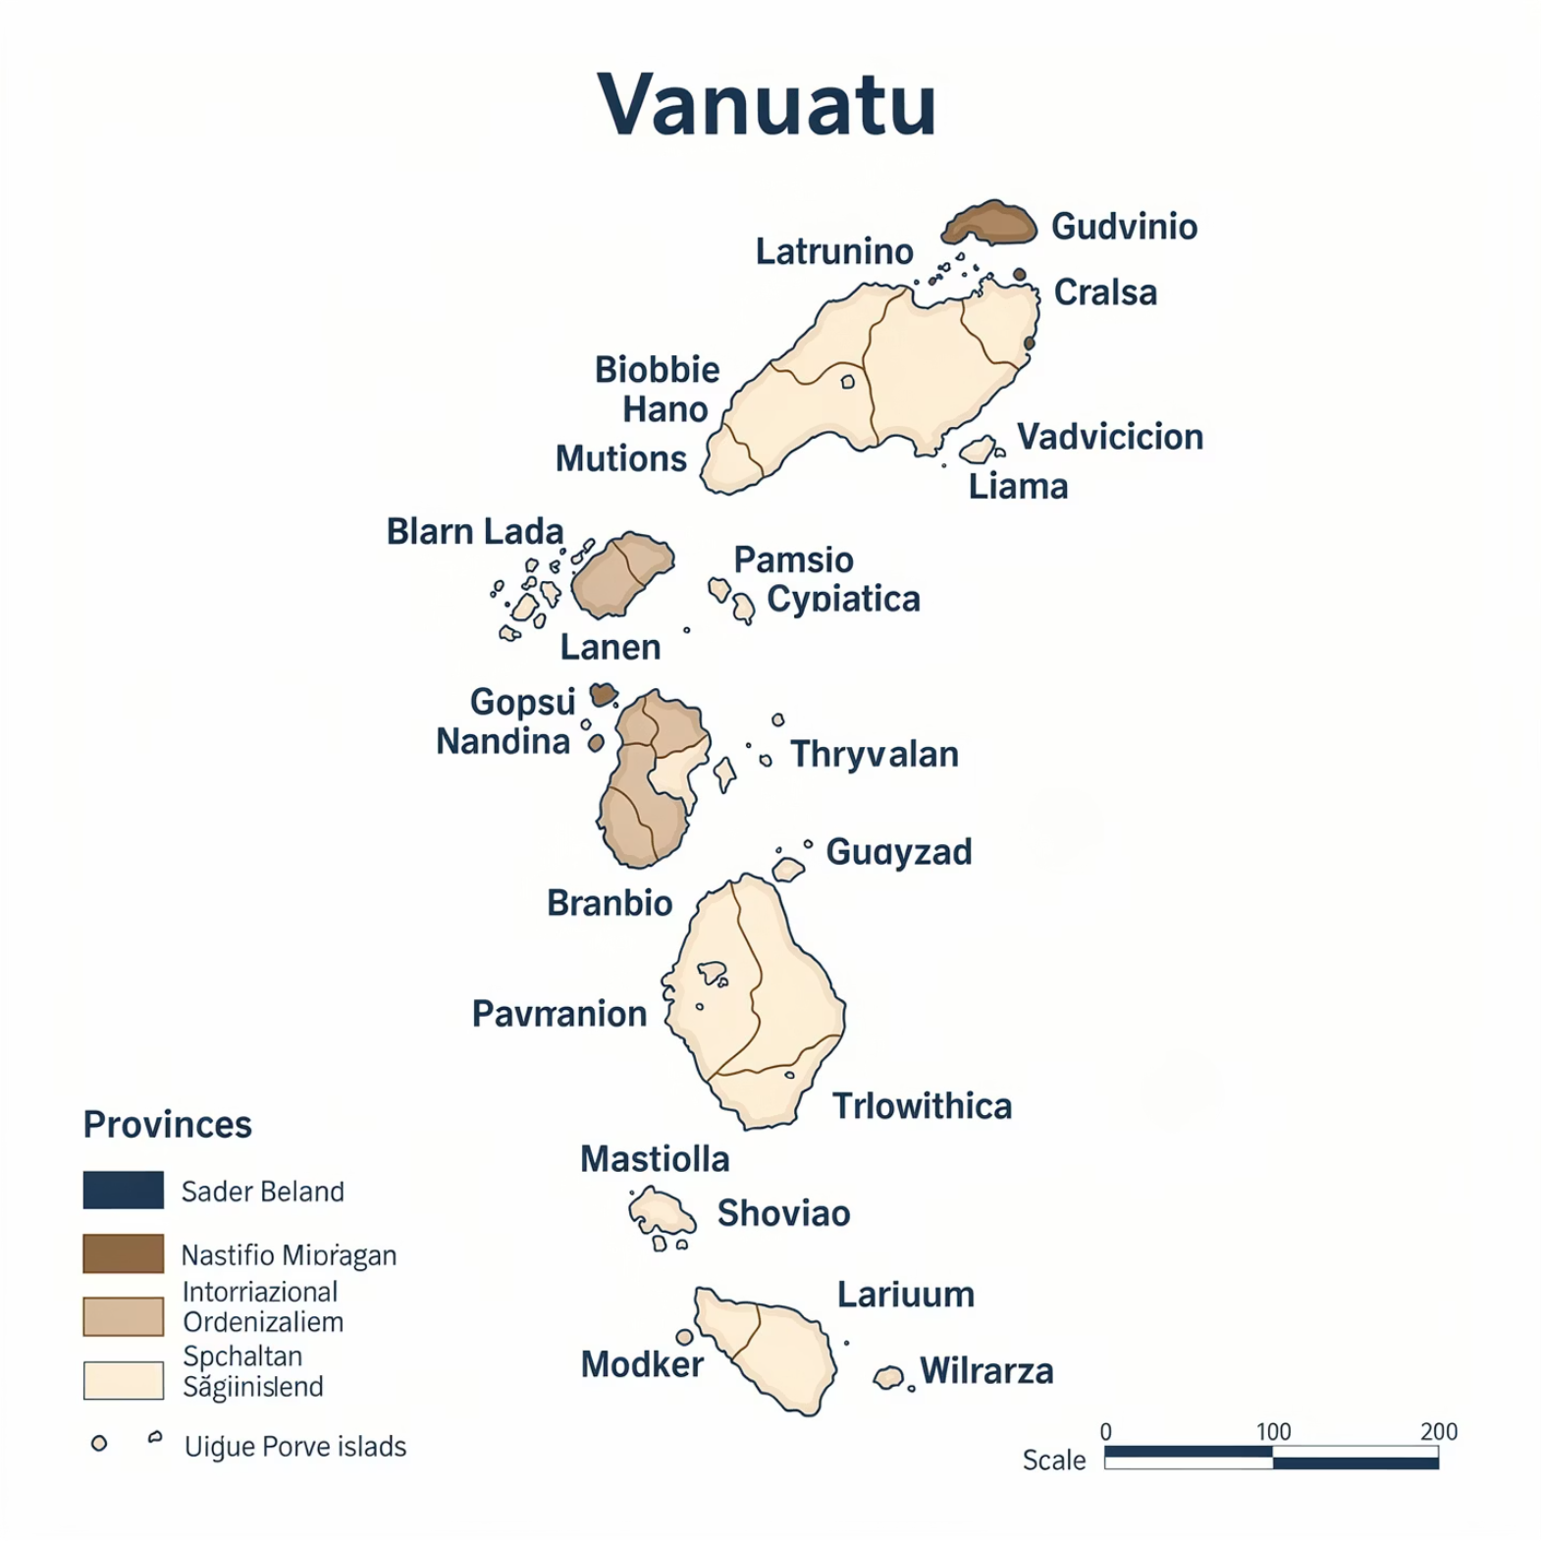
VANUATU EMERGENCY RESPONSE
Displacement Evacuation Center Management (DECM) Cluster
Situation Report — Vanuatu | Reporting Period: [Date] | Issue No: [XX]
🏛Co-Lead
International Organization for Migration (IOM)
🏛 Co-Lead
National Disaster Management Office (NDMO)
💰 Donor
Australian Aid
📋 Cluster
DECM Cluster - Vanuatu
Key Figures at a Glance
The following figures reflect the latest verified data reported by cluster partners operating across active Evacuation Centers
(ECs) in Vanuatu. All data is subject to revision as assessments continue.
[XX,XXX]
[XX]
Total IDPs
Evacuation Centers
Internally displaced persons currently registered
across all active ECs
Active evacuation centers currently operational nationwide
[XX,XXX]
[XX,XXX]
People in Need
People Reached
Total estimated population requiring humanitarian
assistance
Individuals who have received at least one form of
humanitarian support
Children (Under 18)
Sex Ratio
[XX,XXX] children identified in ECs, representing approximately [XX]% of total IDP population. Unaccompanied minors: [XX]
Female: [XX]% | Male: [XX]%
Gender-disaggregated data collected at all registered ECs
Age Distribution
Vulnerabilities
0–5 yrs: [XX]% | 6–17 yrs: [XX]% | 18–59 yrs: [XX]% |
60+ yrs: [XX]%
Persons with disabilities: [XX] | Pregnant & lactating
women: [XX] | Elderly at risk: [XX]
Operational Overview & Context
📍 Affected Provinces: [Province 1], [Province 2], [Province 3] | Trigger Event: [Cyclone / Earthquake / Volcano] | Declaration Date: [DD/MM/YYYY]
[Insert 3–4 sentence situational overview here. Describe the triggering event — e.g., cyclone, volcanic activity, seismic event — the affected provinces, displacement trends, and the current operational posture of the DECM cluster. Reference the activation date of ECs and any evolving protection concerns.]
Situation Photograph
Map of Vanuatu — EC Locations
Photo: [Credit / Source] — [Caption describing scene, location, date]
Partner Logos
Indicative map showing Vanuatu's provincial
boundaries and key EC locations.

Slide 2




SECTOR UPDATES
Cluster Sector-Specific Updates
Reporting Period: [DD/MM/YYYY – DD/MM/YYYY] | Vanuatu DECM Cluster
The following updates are provided by cluster focal points across each active sector. All figures are preliminary and based on partner reporting. Gaps and priority actions are highlighted for cluster and donor visibility.
💧 WASH — Water, Sanitation & Hygiene
🏠 Shelter & NFI
Situation: [Describe current WASH conditions in ECs — access to safe water, sanitation facilities, hygiene kit distribution status.]
Situation: [Describe shelter conditions — EC capacity vs. occupancy, NFI distribution, structural assessments of facilities.]
Households with safe water access: [XX]%
Latrines constructed / functional: [XX]
Hygiene kits distributed: [XX,XXX]
Key gap: [e.g., water trucking needed in [Province]]
EC occupancy rate: [XX]% (capacity: [XX,XXX] / occupied: [XX,XXX])
NFI kits distributed: [XX,XXX]
Damaged/overcrowded ECs: [XX]
Key gap: [e.g., tarpaulins needed in [area]]
🛡 Protection
🍽 Food Security & Nutrition
Situation: [Describe protection environment — GBV risk, unaccompanied children, separation, security in ECs, access for vulnerable groups.]
Situation: [Describe food distribution status, nutrition screening outcomes, pipeline and gaps.]
GBV cases referred: [XX]
Unaccompanied/separated children: [XX]
PSS sessions conducted: [XX]
Key gap: [e.g., female-only safe spaces required]
People receiving food assistance: [XX,XXX]
Acute malnutrition (SAM/MAM) cases: [XX]
Nutrition screenings completed: [XX]
Key gap: [e.g., fresh food supply disrupted in [Province]]
🏥 Health & Medical
📚 Education in Emergencies (EiE)
Situation: [Describe health service delivery at ECs — mobile clinics, disease surveillance, referrals, mental health support.]
Situation: [Describe access to learning for children in ECs — Temporary Learning Spaces (TLS), attendance, psychosocial support in schools.]
Medical consultations conducted: [XX,XXX]
Disease alerts / outbreaks: [XX]
Referrals to health facilities: [XX]
Key gap: [e.g., medical supplies stock-out in [area]]
Children enrolled in TLS: [XX,XXX]
TLS established: [XX]
Teachers trained / deployed: [XX]
Key gap: [e.g., learning materials shortage]
📦 Logistics & Coordination
Active cluster partners: [XX]
Last cluster meeting: [DD/MM/YYYY]
Next cluster meeting: [DD/MM/YYYY]
Coordination platform: ReliefWeb / HDX / [URL]
⚠️ Priority Gaps
🔜 Immediate Actions
📣 Advocacy Ask
[List the top 2–3 unmet needs or access constraints requiring urgent cluster attention or donor escalation.]
[List 2–3 planned responses or coordinated actions the cluster will undertake in the next 72 hours or reporting cycle.]
[Summarize the single most important ask to donors, government, or coordination actors — funding gap, access issue, or policy decision required.]
Contact & Distribution: This sitrep is produced by the DECM Cluster Coordination Team. For further information, contact: IOM Vanuatu — [email@iom.int] | NDMO — [email@gov.vu] | Cluster mailing list: [decm-cluster@gmail.com] | Published on ReliefWeb: [URL]

